Slide 1

Advancing the Kansas State Motto for the benefit of Kansas, America and the World.
Notes:
Welcome to the third, Ad Astra Kansas Galaxy Forum. I’m Ken Moum and I’m here to answer a simple question.

Slide 2
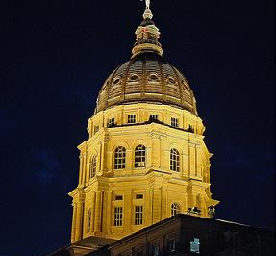
Notes:
So what it the Ad Astra Kansas Initiative, anyway? Click

Slide 3
So what is the Ad Astra Kansas Initiative anyway?
It all started with the Kansas State Motto —
Notes:
It is, obviously, about our state motto, do you know what it is?

Slide 4
So what is the Ad Astra Kansas Initiative anyway?
It all started with the Kansas
Ad Astra per Aspera
Notes:
Exactly, it’s Astra per Aspera. Do you know what that means?

Slide 5
So what is the Ad Astra Kansas Initiative anyway?
It all started with the Kansas
Ad Astra per Aspera
To the stars through difficulty
Notes:
Exactly, To the Stars through difficulty. Do you know how that came to be the state motto? Well, that’s a story that begins in the last days of Kansas’ territory, and beginning if it’s statehood. And it revolves around a young lawyer

Slide 6
Blame it on a lawyer?
Believe it or not the state motto—and, in a way, our organization—began 150 years ago when a young lawyer from Massachusetts saw an ad promoting Kansas—so he moved here.
His name was John James Ingalls
Notes:
This is no lawyer joke, Ingalls was a young lawyer from Massachusetts:

Slide 7
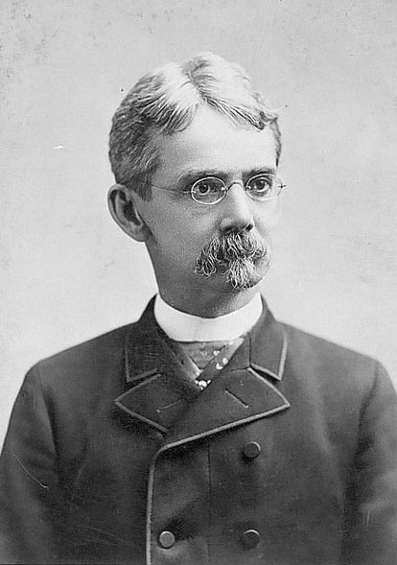
John James Ingalls, born 1833 in Middleton, Mass.
Notes:
He did read an ad about Kansas and…

Slide 8
John James Ingalls, born 1833 in Middleton, Mass.
Moved to Kansas in 1859
Notes:
moved here in 1859.

Slide 9
John James Ingalls, born 1833 in Middleton, Mass.
Moved to Kansas in 1859
Member of the 1859 Wyandotte Constitutional Convention
Notes:
Perhaps what’s most remarkable is that the same year he arrived, in his 20s, he was a member of the 1859 Wyandotte Constitutional Convention.

Slide 10
John James Ingalls, born 1833 in Middleton, Mass.
Moved to Kansas in 1859
Member of the 1859 Wyandotte Constitutional Convention
He also had an idea for a state seal.
Notes:
As important as that was, He also had an idea for a state seal.

Slide 11
Ingalls suggested:
A single star rising from the clouds at the base of a field,
Notes:
Talking about his proposed seal, Ingalls said "I was secretary of the Kansas state senate at its first session after our admission in 1861. A joint committee was appointed to present a design for the great seal of the state and I suggested a sketch embracing a single star rising from the clouds at the base of a field,

Slide 12
Ingalls suggested:
A single star rising from the clouds at the base of a field,
The constellation (representing the number of states then in the Union) above
Notes:
with the constellation (representing the number of states then in the Union) above,

Slide 13
Ingalls suggested:
A single star rising from the clouds at the base of a field,
The constellation (representing the number of states then in the Union) above
The motto, "Ad Astra per Aspera."
Notes:
accompanied by the motto, "Ad Astra per Aspera.“
So what did we end up with? A seal designed by a committee….

Slide 14
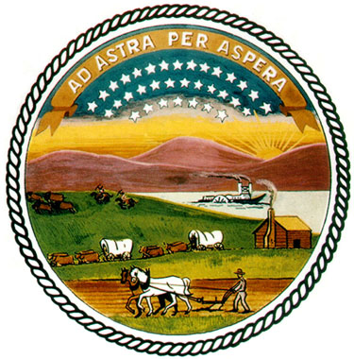
The Great Seal of the State of Kansas
Notes:
Ingalls concept would have been a simple and elegant seal, but like a lot of other things done by committee, it sort of got out of hand.
Said Ingalls -- "If you will examine the seal as it now exists you will see that my idea was adopted, but in addition thereto the committee incorporated a mountain scene, a river view, a herd of buffalo chased by Indians on horseback, a log cabin with a settler plowing in the foreground, together with a number of other incongruous, allegorical and metaphorical augmentations which destroyed the beauty and simplicity of my design.“
So the state motto was the genesis our little initiative, but how did we get from there to 2011 and Kansas Sesquicentennial year?

Slide 15
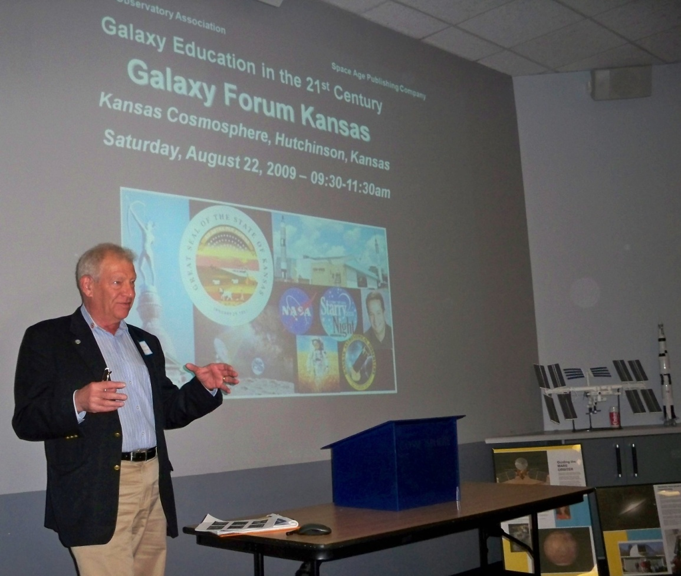
The vision of a Californian, who loves Kansas and what it stands for
Notes:
Well, it happened because of the passion of a Californian who loves Kansas, and is even more intrigued by our state and its place in American history, as midway USA, and America's breadbasket.
Our state motto was the capper, because it points to the past, current and future.
Steve Durst, our founder, first visited here in the 1970s and over the next 30 years, he made at least a half-dozen visits to Kansas.

Slide 16
In 2001 Steve proposed the creation of an initiative supporting interstellar R&D. That would be the Ad Astra Kansas Initiative.
Notes:
In 2001 Steve proposed the creation of an initiative supporting interstellar R&D. It would be the Ad Astra Kansas Initiative.

Slide 17
In 2001 Steve proposed the creation of an initiative supporting interstellar R&D. It would be the Ad Astra Kansas Initiative.
From the beginning, the initiative had a number of goals:
Notes:
From the beginning, the intiative had the goals of:

Slide 18
In 2001 Steve proposed the creation of an initiative supporting interstellar R&D. It would be the Ad Astra Kansas Initiative.
From the beginning, the intiative had the goals of:
  Promoting the state motto to its full 21st century potential
Notes:
Promoting the state motto to its fullest 21st century potential

Slide 19
In 2001 Steve proposed the creation of an initiative supporting interstellar R&D. It would be the Ad Astra Kansas Initiative.
From the beginning, the intiative had the goals of:
  Promoting the state motto to its full 21st century potential
  Serving as a hub featuring space-tech research, development and commercialization projects in Kansas for networking and educational purposes.
Notes:
Serving as a hub featuring space-tech research, development and commercialization projects in Kansas for networking and educational purposes.

Slide 20
In 2001 Steve proposed the creation of an initiative supporting interstellar R&D. It would be the Ad Astra Kansas Initiative.
From the beginning, the intiative had the goals of:
  Promoting the state motto to its full 21st century potential
  Serving as a hub featuring space-tech research, development and commercialization projects in Kansas for networking and educational purposes.
  Recognizing cutting edge research being done in Kansas.
Notes:
Recognizing cutting edge research being done in Kansas.

Slide 21
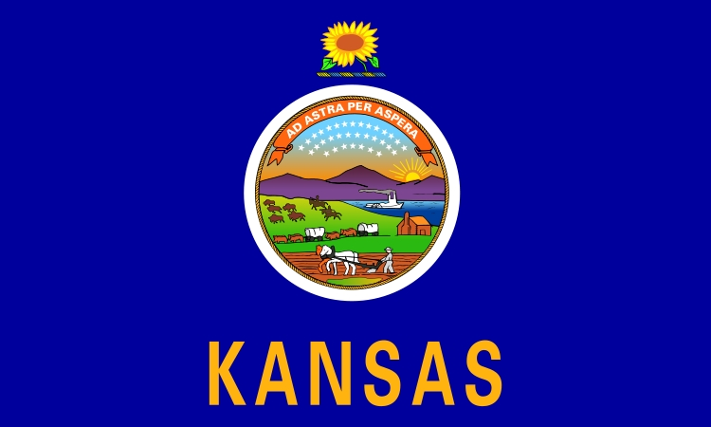
More than just words on a flag
Notes:
The intiative is actually run by a Kansas native, Jeanette Steinert, who lives in Hutchinson. I work for her and Steve, maintaining the initiative's web site writing, editing and doing various promotional tasks. What we hope for is to have Kansas known nationally, even internationally as the Ad Astra state and for Kansans to see the motto as more than words on a flag—and make it more meaningful, relevant, personal to people.

Slide 22
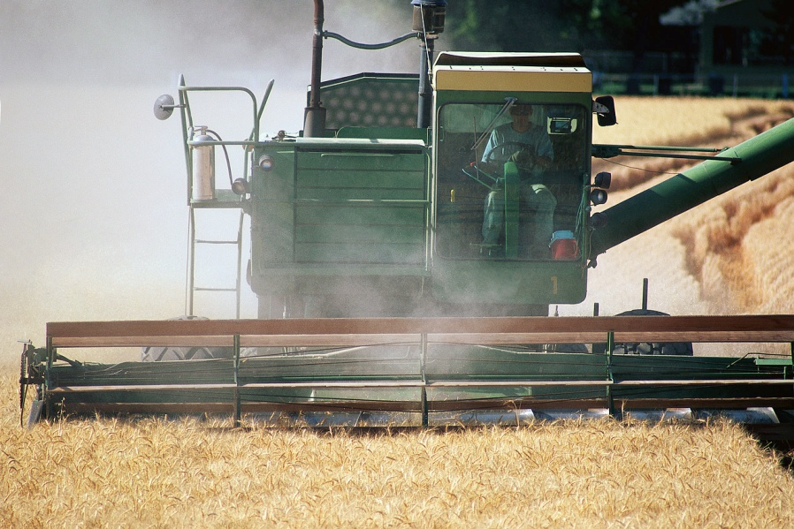

Notes:
We want to change people's perspective, for them to see that Kansas is not just a rural state, or the sunflower state but that there are many facets to our state and our motto. To look forward as well as backward.
We think it’s important to recognize that Kansas is the Ad Astra State

Slide 23
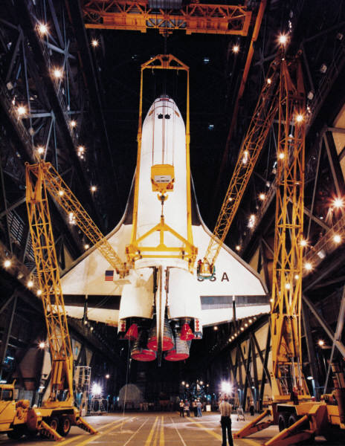
Science, Technology, Engineering & Mathematics
Notes:
Because young people are the future, we feel that one of our most important programs is the advancement of Science, Technology, Engineering and Mathematics education. There's no doubt that our state belongs in the 21st century

Slide 24
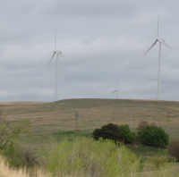
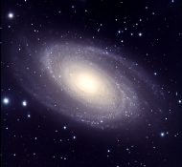
We belong in the 21st Century.
Notes:
whether it means going to the stars figuratively with our cutting edge wind energy and biotechnology or literally into space by developing space technology. As someone once said, “Flight may have been born somewhere else, but it grew up here.” Kansas Academy of Science is 2nd oldest society of its kind in the U.S. The Cosmosphere is, after all, in Kansas, not Houston or Cape Canaveral

Slide 25
Notes:
To that end, Jeanette and Steve have been publishing a semi-annual newsletter since 2002

Slide 26
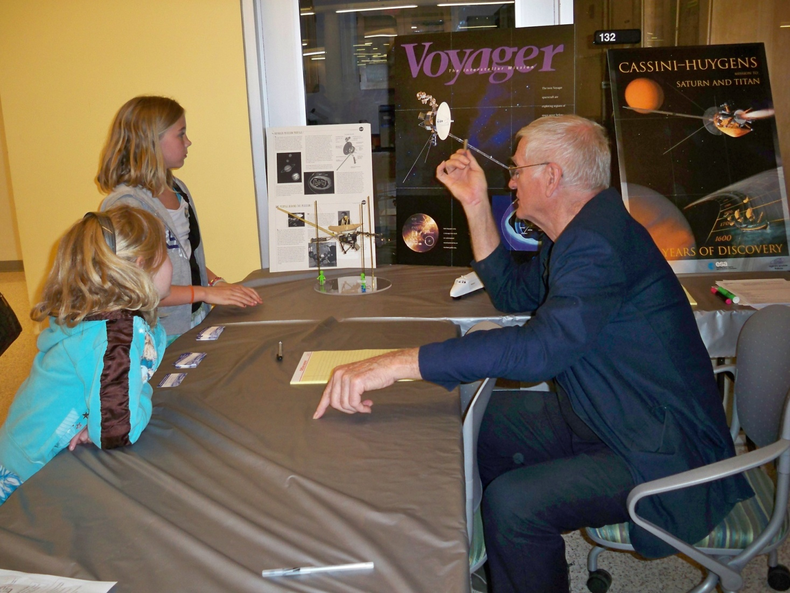
Ad Astra Kansas Day
Notes:
We created Ad Astra Kansas Day, celebrated in April to commemorate the launch of the Hubble Space Telescope which was deployed by native Kansan Steve Hawley.
The last two years we have commemorated it with a science event at Washburn University.
This year we combined fun activities like the Space Ice Cream samples handed out by the WU chemistry club, with presentations by like that by Fundamental Tech. founder Tom Armstrong, who is collecting and analyzing data from the Voyager and Cassini Spacecraft missions to the out planets.

Slide 27
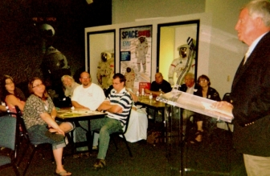
Galaxy Forums, 2009, 10, 11
Notes:
We have held Galaxy forums for three years now, here at the Cosmosphere

Slide 28
150 Super Scientists
Notes:
For the Sesquicentennial Year, we have selected 150 super scientists, and created a set of trading card for use in the classroom and elsewhere. Each of them highlights one scientist with a Kansas connection, offering a photo of the scientist on the front of the card and a list of biographical and career details on the back. They cover a wide range of scientists, from historical figures likeGeorge Washington Carver, and this one---Clyde Cessna one of the fathers of general aviation. To the more modern ones such as Samantha Wisely…

Slide 29
Notes:
Who is member of the recovery team for the blackfooted ferret, one of the iconic mammals of the prairie.

Slide 30
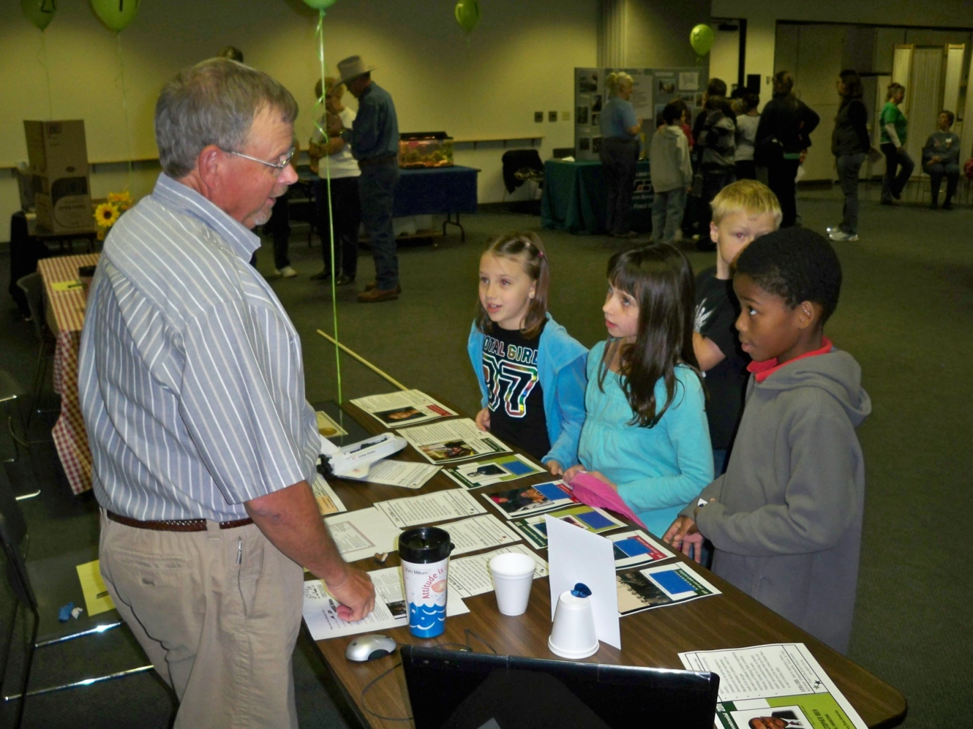
Kansas History and Environmental Fair
Notes:
This year, I participated in the Kansas History and Environmental Fair, where several thousand elementary-school students visit the Kansas Museum of History for the day. We intend to continue those activities, and expand on them. But the future of our initiative is going to be decided this fall.

Slide 31
Ad Astra Founder’s Event
November 3-5, 2011 in Topeka
Notes:
November 3, 4 and 5 will convene for a Founder’s Event that aims to:

Slide 32
Ad Astra Founder’s Day
November 3-5, 2011in Topeka
Organize a board of directors
Notes:
Organize a board of directors

Slide 33
Ad Astra Founder’s Day
November 3-5, 2011in Topeka
Organize a board of directors
Build a consensus about the initiative's future
Notes:
Build a consensus about the initiative's future

Slide 34
Ad Astra Founder’s Day
November 3-5, 2011in Topeka
Organize a board of directors
Build a consensus about the initiative's future
Begin the development of bylaws and resolutions
Notes:
Begin the development of bylaws and resolutions

Slide 35
Ad Astra Founder’s Day
November 3-5, 2011in Topeka
Organize a board of directors
Build a consensus about the initiative's future
Begin the development of bylaws and resolutions
Establish Ad Astra Kansas as a 501(c)3 corporation
Notes:
Establish Ad Astra Kansas as a 501(c)3 corporation

Slide 36
Ad Astra Founder’s Day
November 3-5, 2011in Topeka
Organize a board of directors
Build a consensus about the initiative's future
Begin the development of bylaws and resolutions
Establish Ad Astra Kansas as a 501(c)3 corporation
Can you help us get there from here?
Notes:
Can you help us get there from here?

Slide 37
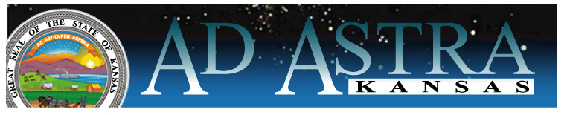

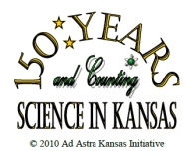
Thank you

